Slide 1
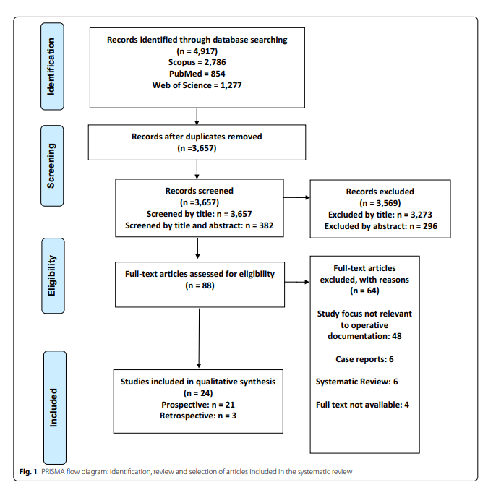
Records identified through database searching
(N=4,630)
Scopus=775
IEEE Xplore = 104
ACM=1,1315
Springer Link=2,436
Identification
Records after duplicate removed
(N=4,241)
Screening
Records screened (N=4,241)
Screened by title and abstract (N=4,241)
Records excluded by title and abstract
Applying IC1, IC2, EC2
(n=4,124)
Full-text articles assessed for eligibility
(N=117)
Full-text articles excluded, with reason:
(N=60)
IC3
Eligibility
Studies included in qualitative synthesis after applying IC3, EC3, and EC4
(N=57)
Included

Slide 2
Applying the search query through the digital libraries: Scopus(N=775), IEEE Xplore (N=104), ACM (N=1,1315), Springer Link(N=2,436)
Total studies (N=4,630)
Applying the exclusion and inclusion criteria of IC-1 and EC-1
389 studies were removed
Total studies (N=4,241)
Reading metadata information of the studies (title, abstract, keywords)
Applying the exclusion and inclusion criteria of IC-2 and EC-2
4,124 studies were removed
Total studies (N=117)
Reading the entire content of the studies
Exclude the studies that are not related to any of the research questions, and apply the EC-3 criterion
44 studies were removed
Total studies (N=73)
Reading the empirical study of the studies, and the explanation of details
Applying the exclusion and inclusion criteria of IC-3 and EC-4
16 studies were removed
Total studies (N=57)

Slide 4
